Slide 1
Making Europe a world-leader in rare diseases research and innovation
Training session:
Best practice to enable use and sharing of iPSCs

Slide 2

Overview
Introduction to EBiSC
Ethics for iPSC research
Legals
Quality control
Data Management
Sustainability of iPSC research

Slide 3
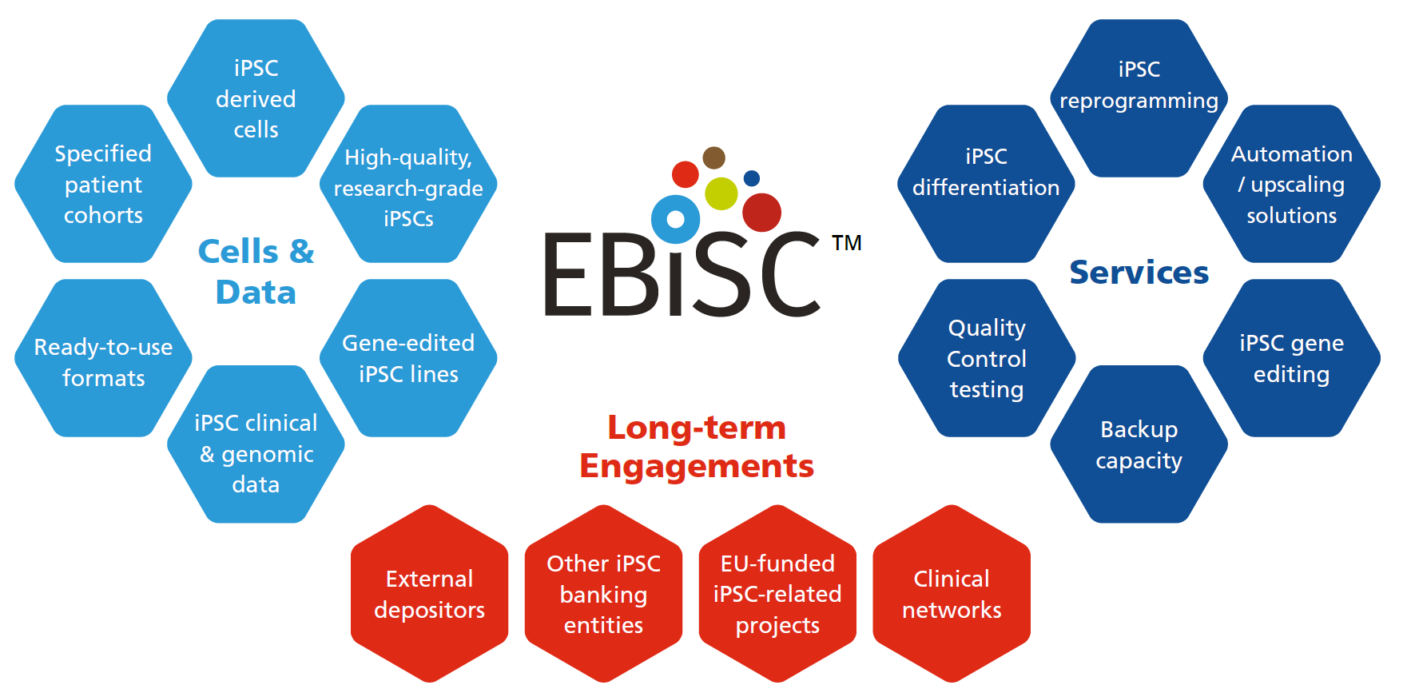

European Bank for iPSCs
A not-for-profit, centralised biobank for iPSCs.

Slide 4
European Bank for iPSCs
A European resource working to:
Increase sharing of iPS cells and data
Improve the quality of iPSC research
Reduce the ‘silo’ effect
Increase reusability, reproducibility and efficiency of iPSC research
Respect the wishes of patients and the public who have gifted cells to science to accelerate research

Slide 5
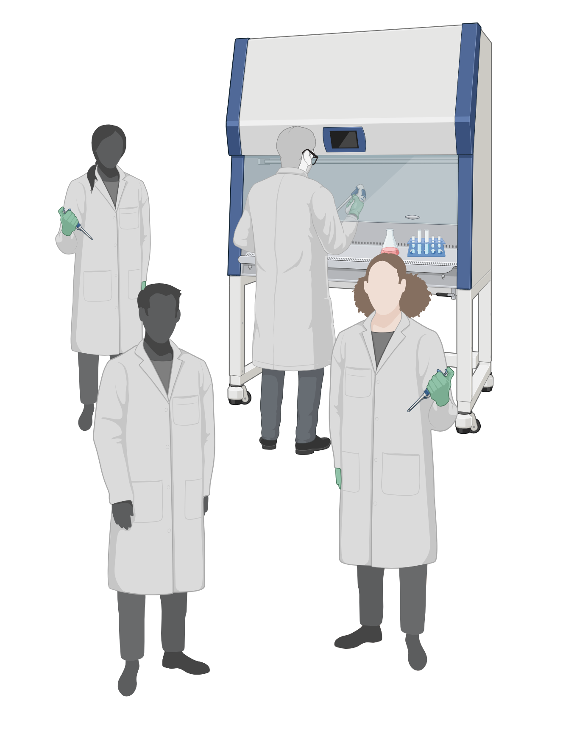
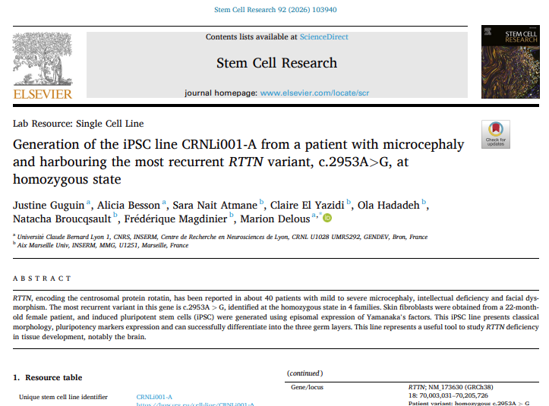
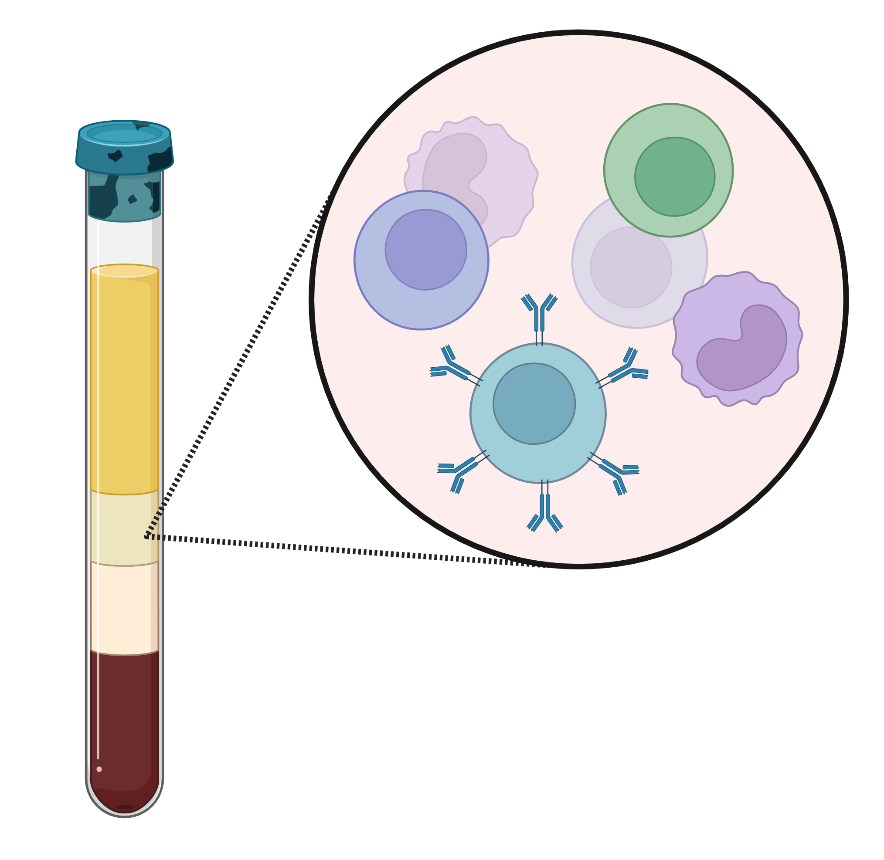
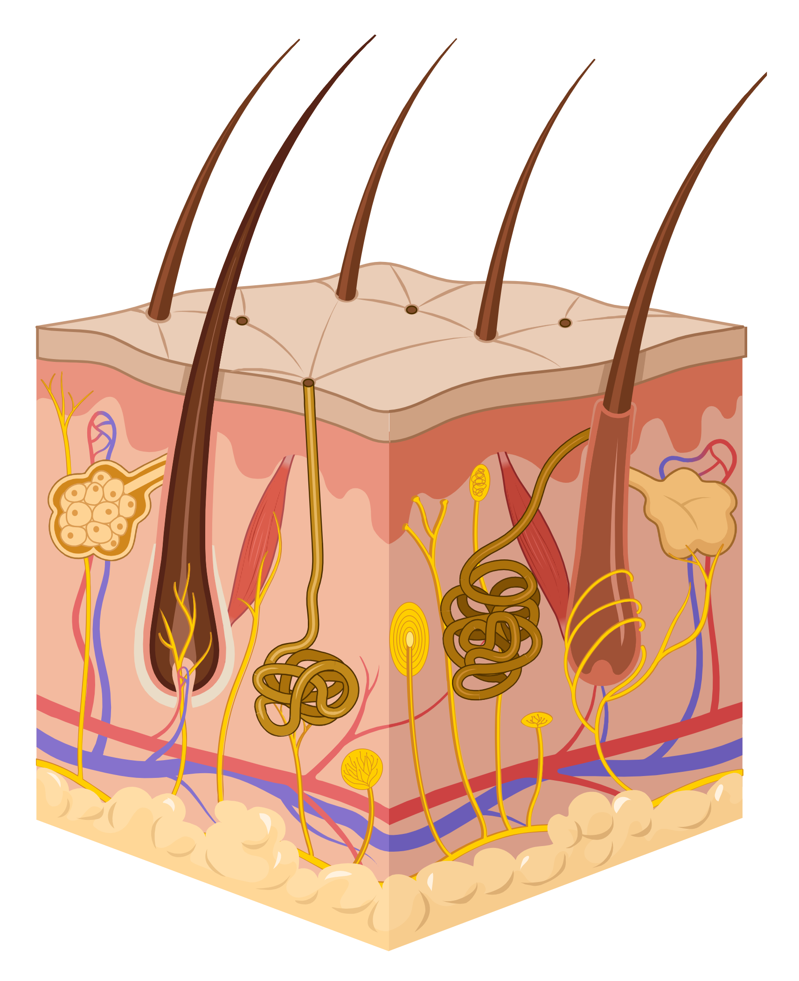
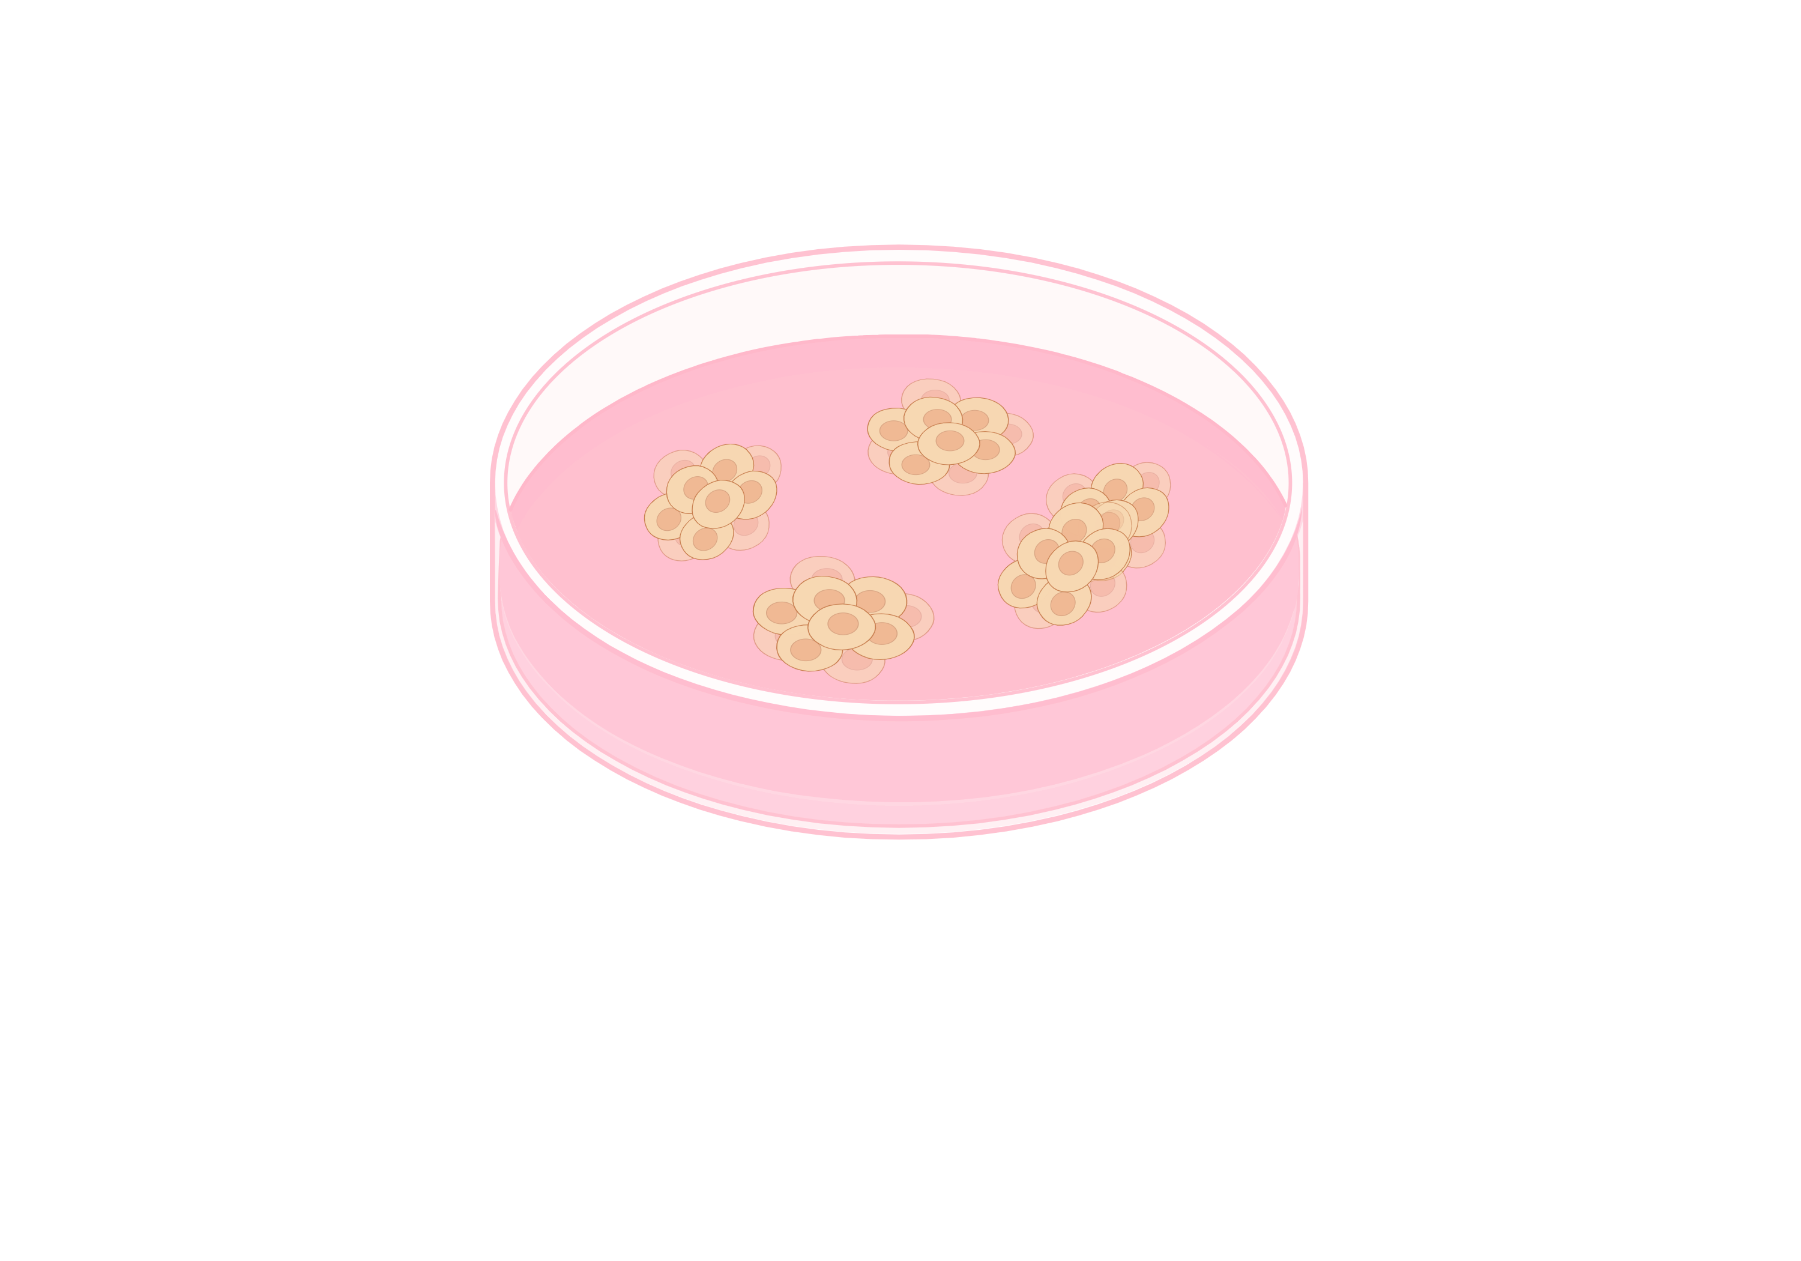

The path to iPSCs for research – the ‘silo’ effect
Participant
recruitment
Biosample collection
Use of iPSCs
for research
Sharing resources
& data
iPSC reprogramming
Open access biobanks and repositories.
Online searchable catalogue
Simplified access
Full QC
Ethical and legal provenance
Data protection
Amplified impact
Long term plan
Essential for rare disease research
iPSCs from many different sources, all openly listed in one place.

Slide 6
The path to iPSCs for research
A trail of critical documentation.
Participant recruitment
Informed consent documentation.
Biosample collection
MTA for transfer of biosamples for reprogramming.
iPSC reprogramming
Licensing for choice of method and reagents.
Use of iPSCs for research
MTA to share iPSCs.
Communication of legal and ethical terms.

Slide 7
A few questions as food for thought…
Have you, or are you, working with iPSCs?
Have you, yourself, reviewed the linked consent form?
Do you know where or how to access the (template) consent form?
Have you checked the Material Transfer Agreement?
Lastly – how have you named your iPSC line?

Slide 8
The path to iPSCs for research
A trail of critical documentation.
Participant recruitment
Informed consent documentation.
Biosample collection
MTA for transfer of biosamples for reprogramming.
iPSC reprogramming
Licensing for choice of method and reagents.
Use of iPSCs for research
MTA to share iPSCs.
Communication of legal and ethical terms.

Slide 9
Managing informed consent
The Basics
1
2
3
Reviewing consent to assure suitability for iPSC research
Research use restrictions
Documenting and communicating

Slide 10
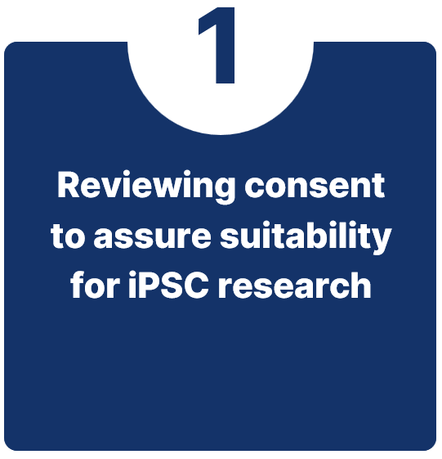
Managing informed consent
Are iPSCs explicitly mentioned?
Is there a reference to sharing or biobanking?
Is genomic analysis explicitly discussed?
Is anonymisation or pseudonymisation discussed?
Is it clear that donation of material is voluntary?
What happens if consent is withdrawn?
Is there a reference to unforeseen or future research?
Future planning – is there consent for commercial use?
Consider: changing consent later is very difficult, if not impossible.

Slide 11
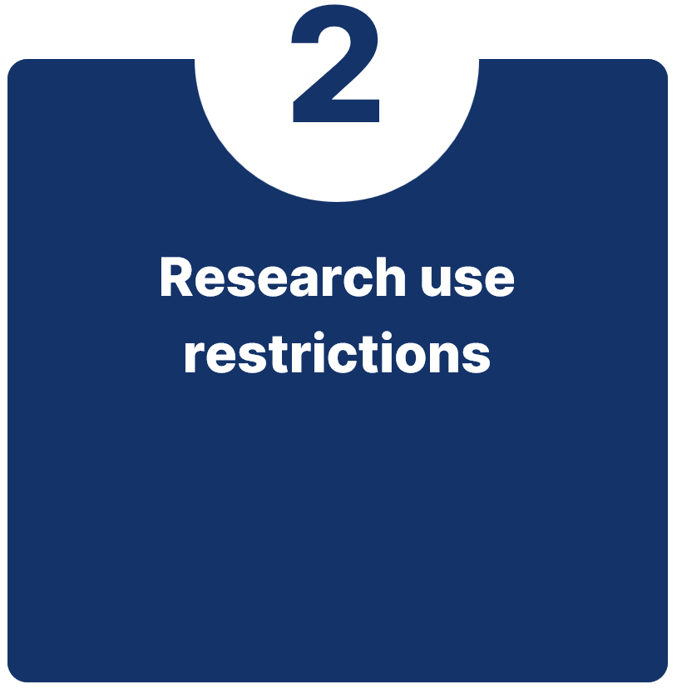
Managing informed consent
What are research use restrictions?
    Limitations on how collected samples and derivatives (i.e. iPSCs) can be used.
Examples:
    “I voluntarily consent to donate this sample for use in research into Parkinson’s disease and other movement disorders”
    “Donated samples will be used by researchers in the UK and Europe.”
    “Use of samples and derivatives will be governed by a local research ethics committee.”

Slide 12
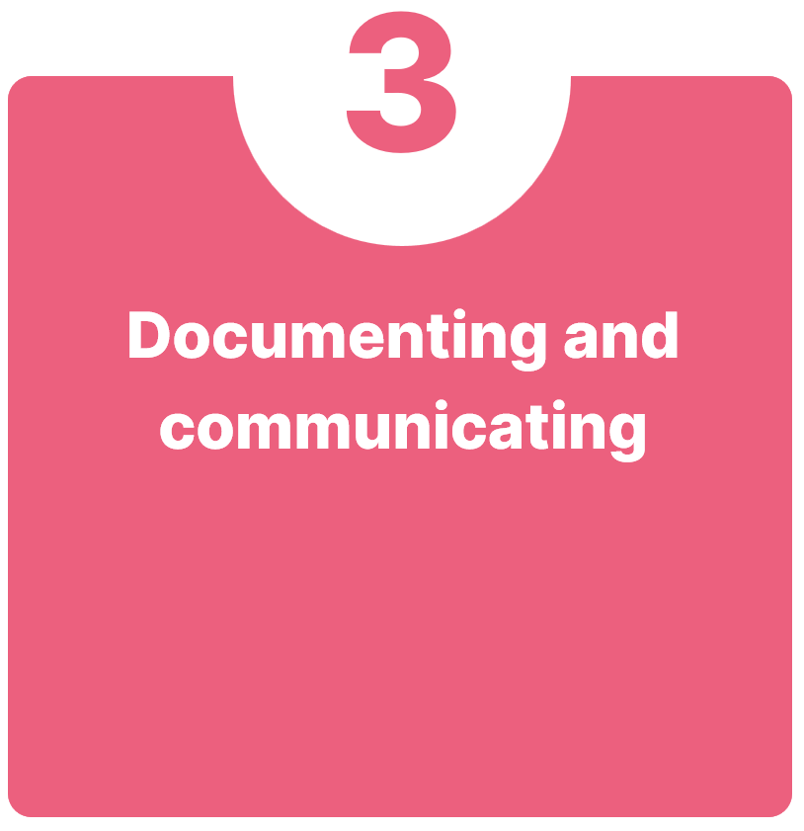
Managing informed consent
Plan for longevity – iPSCs can be shared, stored and used over decades.
The content of consent (i.e. the entire templates) has to be reviewable by researchers using the iPSC line, over that entire time period
Consider:
  Where will consent templates / terms of use be stored?
  How will they be linked to (all) the associated iPSCs?
  How will they be accessible if the iPSCs are shared with others?
Notes:
Consider that it is not just the original iPSC line, but any derivatives which may be generated and shared from that

Slide 13
The path to iPSCs for research
A trail of critical documentation.
Participant recruitment
Informed consent documentation.
Biosample collection
MTA for transfer of biosamples for reprogramming.
iPSC reprogramming
Licensing for choice of method and reagents.
Use of iPSCs for research
MTA to share iPSCs.
Communication of legal and ethical terms.

Slide 14
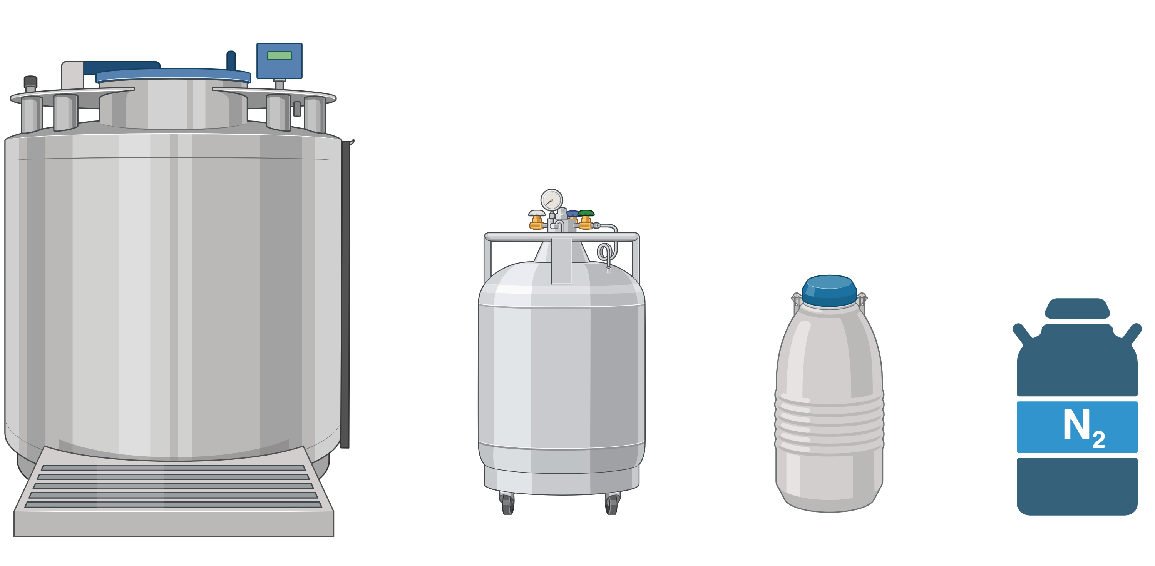
Legal considerations
Biosamples
Biosamples
MTA?
Who has permission to use the primary material?
Are there Material Transfer Agreements covering movement of samples between labs?
Who has ultimate legal responsibility for the iPSC(s) (i.e. ownership)?
    Particularly important when generating iPSCs in collaboration.
How were the iPSCs generated? And using what technology?
    Third party licensing obligations (e.g. reprogramming factors, genetic modification reagents etc)
    Legal use restrictions
    Step 1: contact supplier!
iPSCs
MTA?
Biobanking
MTA?
Researchers

Slide 15
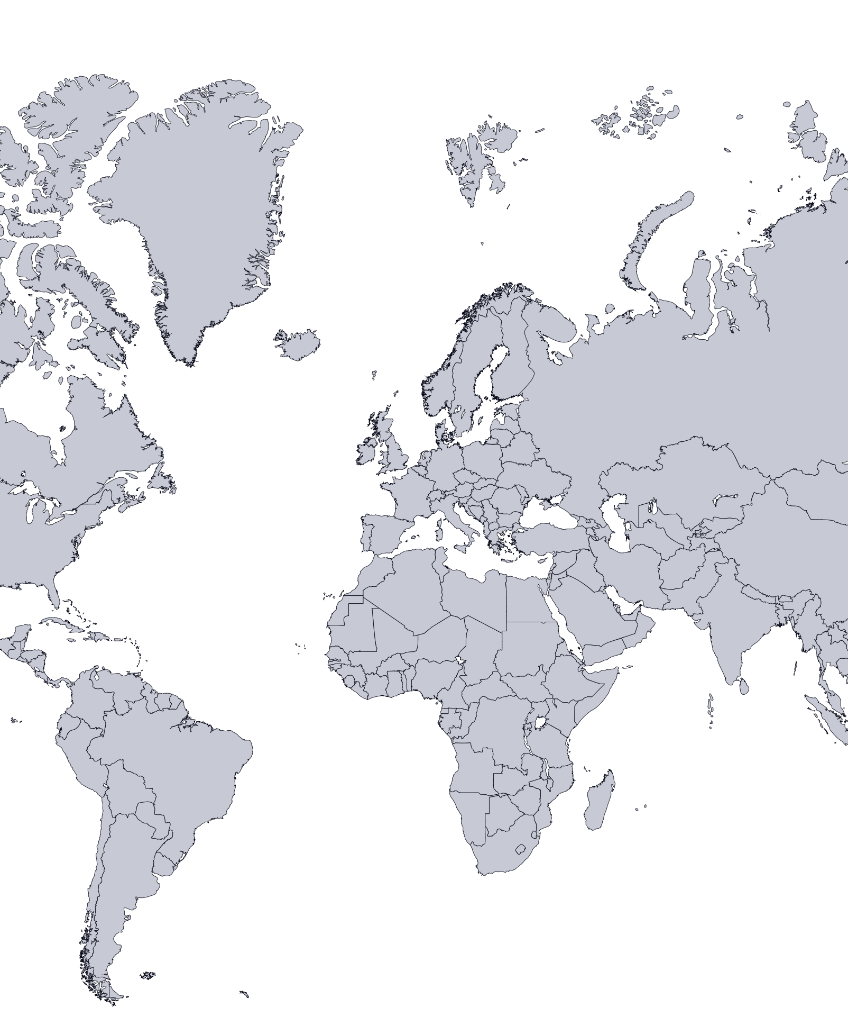
Geographical considerations
Different countries have differing laws and regulations on the use and movement of hPSCs.
For example, in Belgium, the Belgian Biobank Law regulates biobanks and has specific requirements for handling of consent, samples and movement of cells across borders.
Has an impact depending where cells come from vs where cells are going.
Differing data regulations worldwide have different impacts on management and sharing of data (e.g. GDPR vs HIPAA).
Notes:
For instance for Belgium: in case it concerns samples collected in Belgium, or research on samples in Belgium, additional requirements need to be added due to new Belgian legislation (entry into force for existing biobanks on 1 May 2019). These would concern, among others, specification of research purpose (although this can be more general for framework agreements), provision of (template) consent, samples in/out registration requirements, traceability of samples, and reporting medical findings back to donor if they can have an effect on health. Registration of the biobank in Belgium and requirements of administration may also apply.
The Belgian Biobank law was first adopted in 2008, entered into force in 2018 and underwent an important reform in 2022. Moreover, the law is complemented by an essential piece of self-regulation, namely the Compendium on biobanks issued by the Federal Agency on Medicine Products and Health.

Slide 16
iPSC Banking and Quality Control

Slide 17
Reprogramming
Method selection has downstream impact in many aspects.
Primary material
Vector clearance
Biosafety levels
Method selection should match suitably for the primary material type.
Standard QC to demonstrate vector clearance.
Method and clearance status has impact on biosafety regulations internationally.
Worldwide shipping
Rights for use
stability
Method and clearance status has impact on shipping.
Licence for use may have “reach through” rights.
Impact on possible commercial future use.
Reprogramming vector choice and culture method has impact on genomic and clonal stability.
Notes:
Vector positive lines will impact UN code for shipping

Slide 18
Expansion and cryopreservation
A critical stage to ensure quality and consistency
Defined reagents
Batch consistency
cryostorage
Feeder free
Enzymatic passaging
No FBS
Pooling cells prior to filling vials
Inventory
Secure cryostorage
Multi-site back up storage
Nomenclature
Batch Management
Vial labelling
Standardised cell line naming…
..and batch naming….
(Master Bank vs Working bank)
..and ensure vials are labelled appropriately.
Notes:
Feeder free
Cryopreservation
Vial labelling
Nomenclature
Batch identifiers

Slide 19
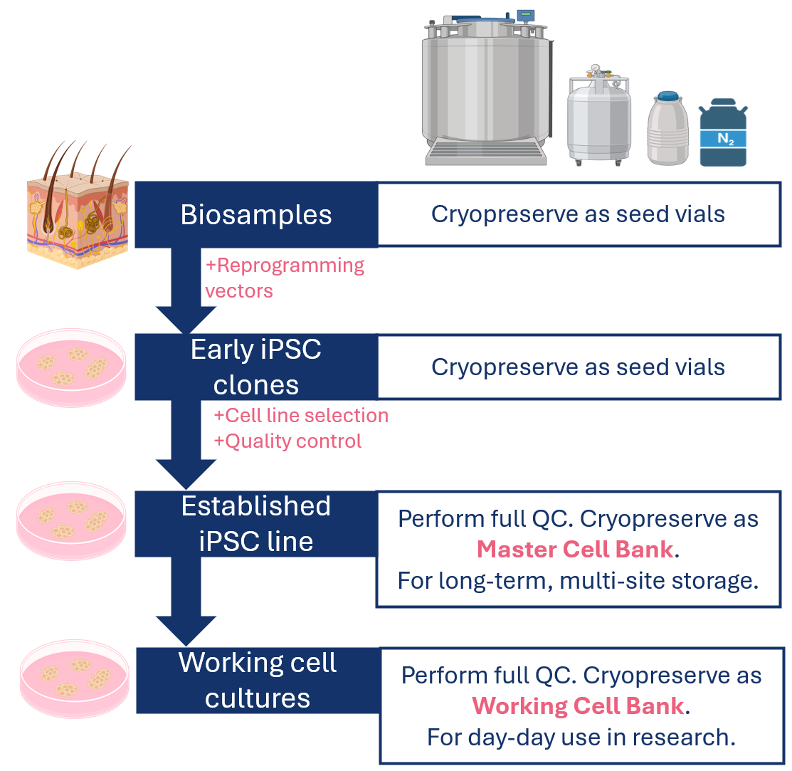
Batch Management
A consistent process for generating and storing cell batches is essential to protect your research.
This includes:
    Cryopreserving at early stages post-reprogramming.
    Master Cell Bank with full QC = long term storage and cell resource
        Cross site storage!
    Working Cell Bank = daily research use
    Consistent batch IDs and labelling for traceability…

Slide 20
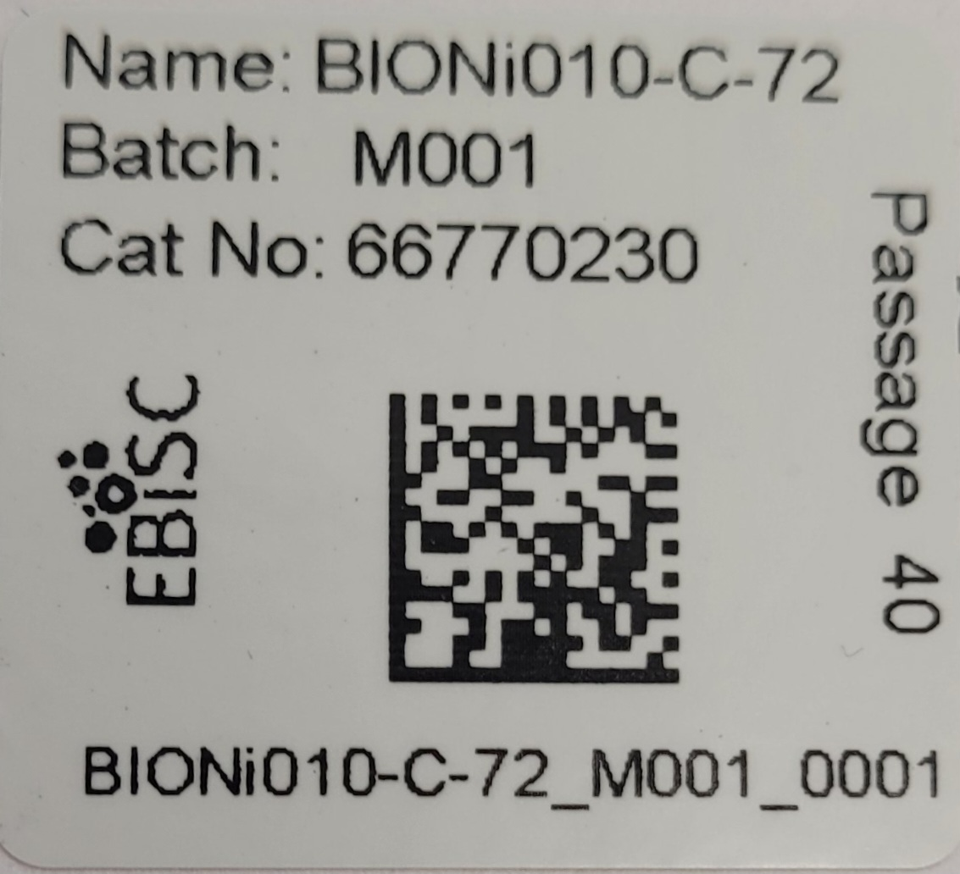
Traceable vial labelling
Unique identifiers for:
    Cell line
    Batch
    Vial
001>050 = Start to end of vial filling
Clear passage number information
Secure adhesive labels (i.e. not written on the vial)
Notes:
Nomenclature should provide informative code to
generate persistent and unique identifier
• Identifier should be linked to donor and STR profile
(authentication)
• Identifier should allow to trace clones and
derivatives to source
• Free to generate (for example, by API)
• Free to access and referenced in a central registry
• Consistent across publishers and journals
• Machine readable and if possible human readable
• Fit on standard tube labels (14-18 symbols)
• Linked to authentication profiles
• Allow FAIR data principle application (findable,
accessible, interoperable and reusable)

Slide 21
Quality Control
Balance and prioritise according to your needs
Strict batch quality control:
Sterility
Mycoplasma
Cell line identity (STR)**
Human viral pathogens (HIV1, HIV2, HBV, HCV) **
Viability
Vector clearance
iPSC line characterisation:
Morphology
hPSC marker expression (internal and surface)
Differentiation potential (in vitro)
Genomic stability**
For GE lines: confirmation of modified locus**
For disease associated lines: confirmation of disease variant**
**QC also to be confirmed in primary material where possible
Screen all incoming material!

Slide 22
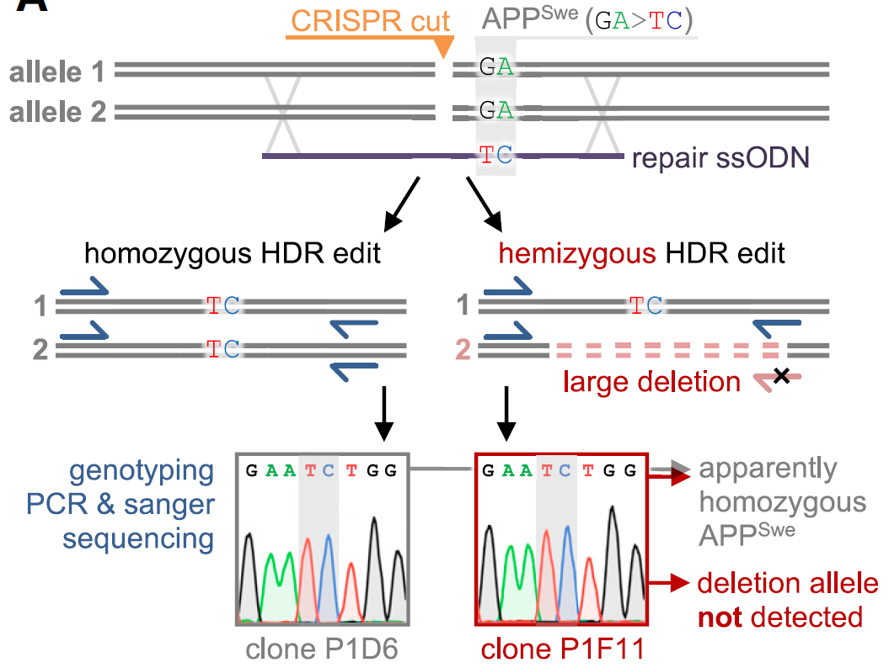
Genetically Modified iPSCs
Gene edited lines obviously require additional QC to characterise the modified locus (See O’Shea, Steeg et al 2020 for detailed overview)
Unintended On-Target Effects should be included in characterisation as this can have large impacts on genotype and function.
Additional QC required to confirm cell line identity in cohort of GE lines from the same donor
Weisheit et al 2020

Slide 23
Monitoring cell quality
A need to regularly monitor cell quality during ongoing culture.
Depends on your research and process flow but decide on:
    Assays
    Frequency
    Pass / fail points
Minimum recommendation:
    All ongoing cultures should be routinely (every 4-6 weeks) checked for:
      Mycoplasma / sterility
      Cell line identity (STR)
    Checking marker expression or genomic stability before starting long-term differentiations.
STR,
Mycoplasma, Sterility
Ongoing research
STR,
Mycoplasma, Sterility

Slide 24
Data Management

Slide 25
Data Management
International Standards
1
2
3
Open Science
(Transparency, sharing and inclusivity)
https://www.cos.io/open-science
FAIR Principles
(Findable, Accessible, Interoperable, Reusable)
https://www.go-fair.org/fair-principles/
CARE Principles
(Collective Benefit, Authority to Control, Responsibility, Ethics)
https://www.gida-global.org/care
Notes:
Open science is a movement aimed at making scientific research, data, and dissemination accessible to all levels of society, fostering transparency, reproducibility, and collaboration. Core principles include open access publishing, sharing research data (often following FAIR principles), and utilizing open-source tools. Key benefits include increased research efficiency, improved public trust, and faster scientific progress.
European Research Executive Agency +4
The CARE Principles for Indigenous Data Governance are a set of guidelines designed to ensure that data collected from or about Indigenous Peoples is used in respectful ways that benefit their communities.

Slide 26
Why are these principles important?
Sharing and re-using cells is dependent on sharing and re-using data.
Required to meet many research requirements e.g. publications, grant applications and funder needs.
Increasing the quality and reproducibility of research is vital to meet the promise of iPSC research.
Adherence will also increase the visibility and impact of YOUR research.
Notes:
Naming (ownership/IP, consistency, publication, data linkage)
Data management (Ethics, generation, characterization)
Increased impact

Slide 27


Human Pluripotent Stem Cell registry
Open access, data management resource
A “cells and data” open access resource for iPSC researchers
Repository for iPS cells
Repository for iPSC data

Slide 28

Human Pluripotent Stem Cell registry
Example hPSCreg id:
EBiSCi001-A
The human Pluripotent Stem Cell registry (https://hpscreg.eu/) is an open access portal to:
  Assign standardised and unique cell line IDs
  Record (non-personal) cell line data
Cell line registration is mandatory for publication in certain journals
Registration and data input provides a long-term, public record of essential cell line data.
EBiSCi001-A-1
-1
Short organisational identifier e.g.
“UOXF”
“BIH”
“i” for iPSC line
Numerical code for donor
Clone code A=first clone
B= 2nd clone etc
Subclone code 1=first subclone
2= 2nd subclone etc
Notes:
Diagram of cell line naming convention

Slide 29

Human Pluripotent Stem Cell registry
Data collection and sustainability
Register
Cell Line ID
Enter Cell Line Data
https://hpscreg.eu/
Submit Cell Line to hPSCreg
Cell Line is validated
hPSCreg issues certificate

Slide 30
Human Pluripotent Stem Cell registry
Data collection and sustainability
Register
Cell Line ID
Unique IDs
Standard stem cell nomenclature (hPSCreg name)
BioSamples ID
Enter Cell Line Data
Cell Line Provider
Generator
Owner
Distributor
Alternative Names
Submit Cell Line to hPSCreg
Donor Data
Disease status
Clinical Features
Genotype
Age
BioSamples Donor ID
Genetic Sex
Ethics / Consent
Cell Line is validated
Cell Line Data
Primary material
Reprogramming
Culture conditions
Pluripotency
hPSCreg issues certificate
STR
HLA Typing
Microbiology / Virology
Publications
Karyotype
Genetic Modification
Functional or –omics data
Allowed usage (research / clinical / commercial)
Application grade (research / clinical track)

Slide 31
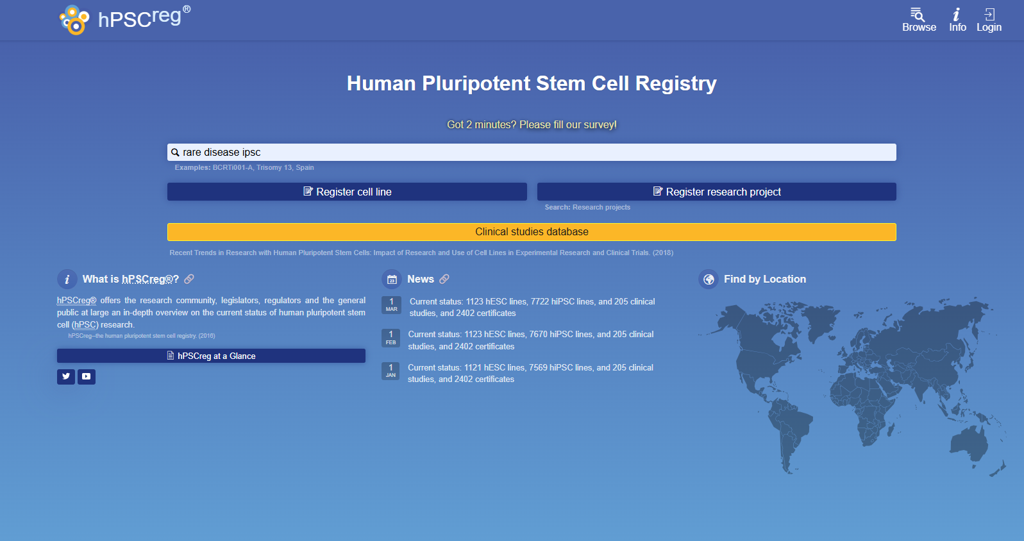
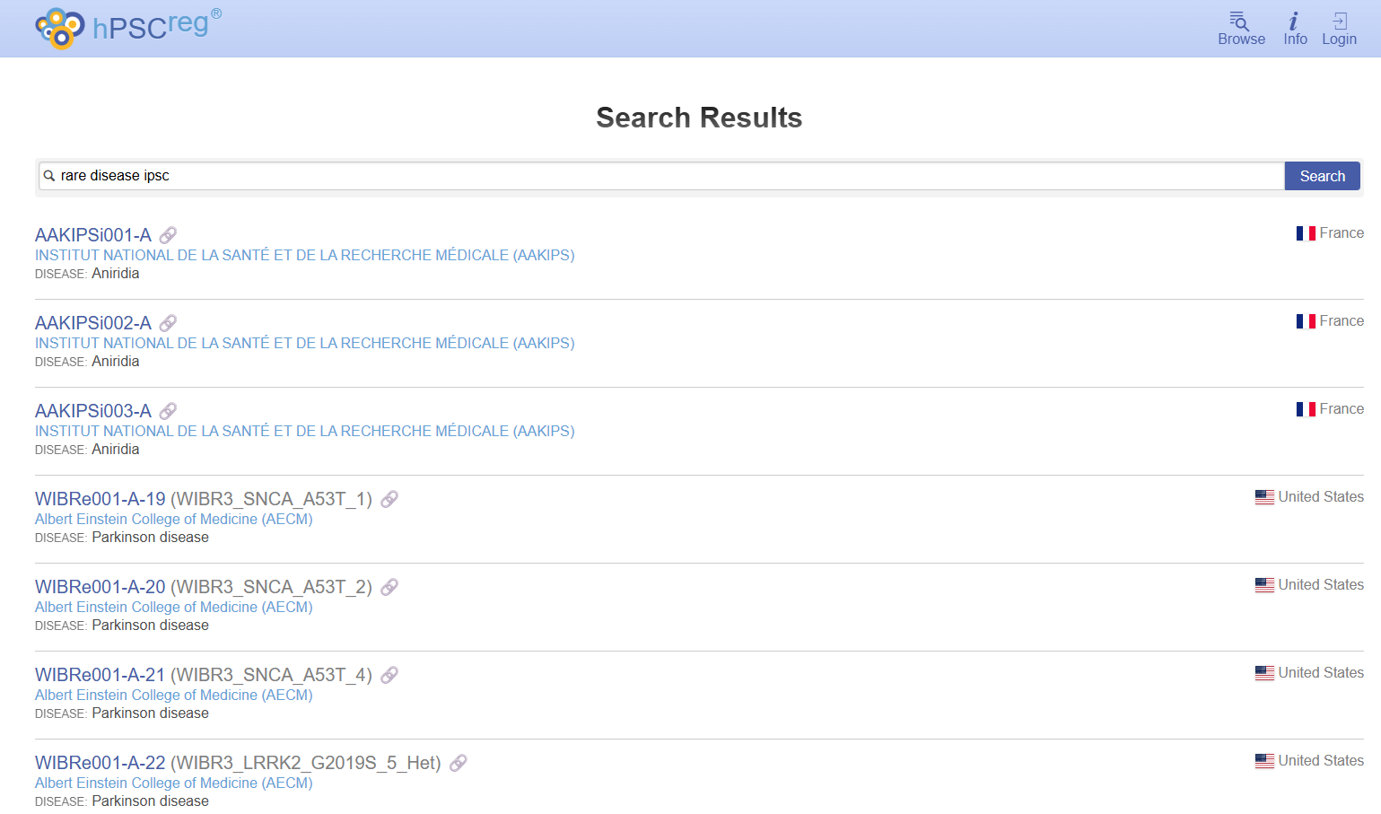
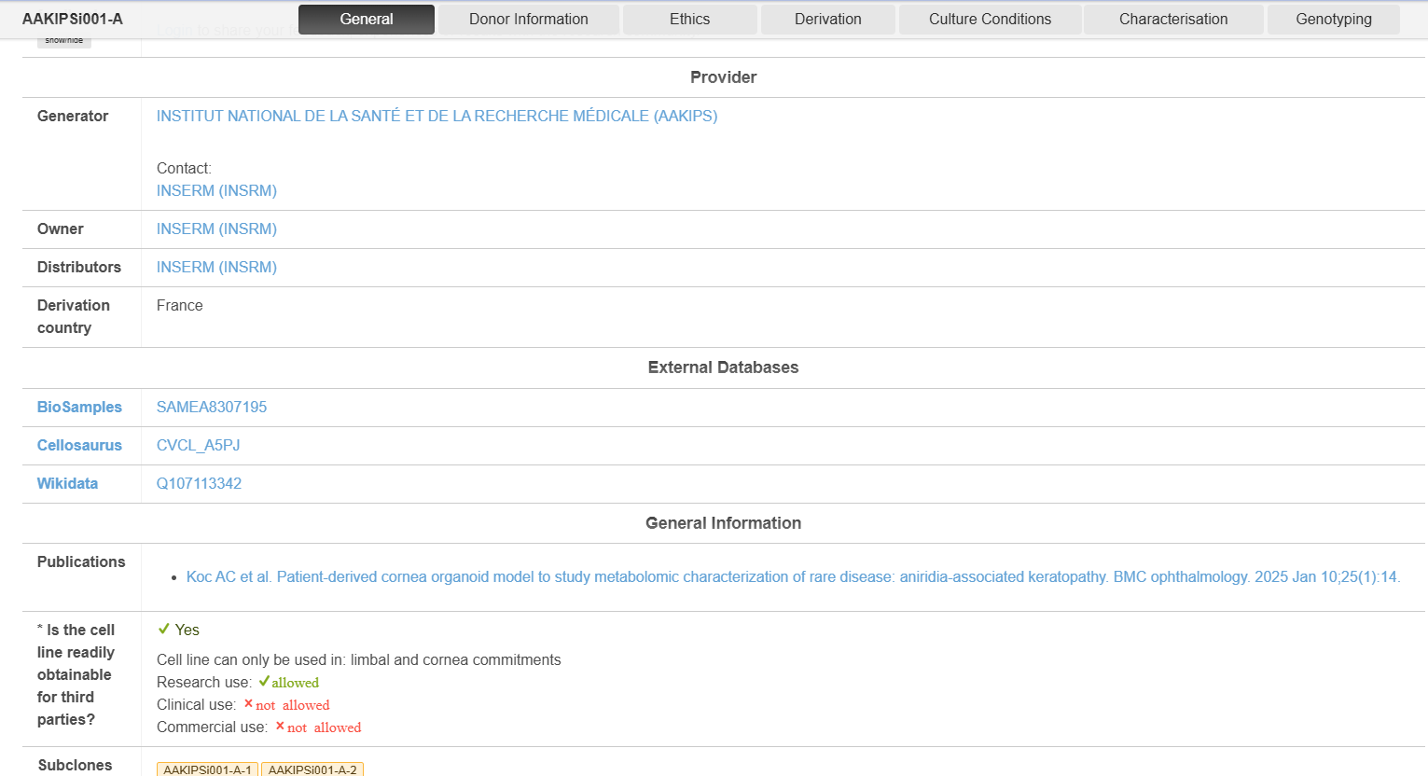
Human Pluripotent Stem Cell registry
Data collection and sustainability

Slide 32
Resources to guide and support your research
Standards:
ISSCR Standards for Stem Cell Research (https://www.isscr.org/basic-research-standards)
EBiSC guidance publications (PMID: 34380020, PMID: 32252012)
Data management:
Human pluripotent stem cell registry (https://hpscreg.eu/)
European Genome-Phenome Archive (https://ega-archive.org/)
DPUK (https://www.dementiasplatform.uk/)
The ERDERA Virtual Platform (https://vp.erdera.org/discovery)
FAIRplus ‘recipes’ and resources to FAIRify your data (https://fairplus-project.eu/resources/)
Need a biobank too share your iPSCs?
EBiSC (www.EBiSC.org)
BBMRI-ERIC (https://www.bbmri-eric.eu/)

Slide 33
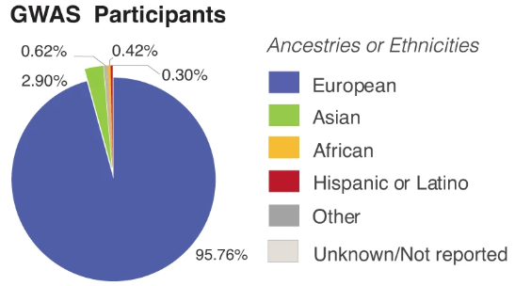
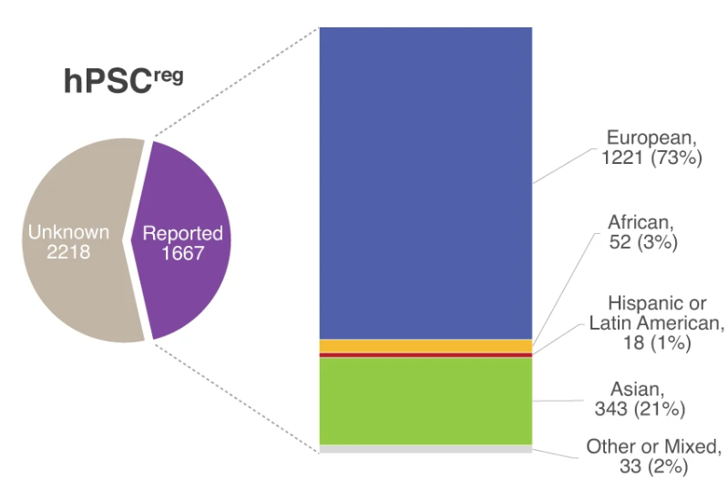
A lack of genetic diversity in stem cell modelling
Ghosh, S., Nehme, R. & Barrett, L.E. Greater genetic diversity is needed in human pluripotent stem cell models. Nat Commun 13, 7301 (2022). https://doi.org/10.1038/s41467-022-34940-z
Notes:
Impacted by many factors including consent, legals for sharing and accurate data records – and agreement on how to notate ancestries and ethnicities – donor led descriptives or genetic definition?

Slide 34
So you’ve made rare disease iPSCs….
What will you do with them now?

Slide 35
So you’ve made rare disease iPSCs….
What will you do with them now?
5 years after your current project ends….
Where will the iPSCs be stored?
How will the cells be shared?
How will the data be shared?
How will they be sustainable?

Slide 36
Main learnings
1
2
3
Make a long term plan for sustainability (Data + Cells).
Actively include populational representation and diversity in your cell models.
Plan early to keep your options open.

Slide 37


www.EBiSC.org
Contact@EBiSC.org
Rachel.Steeg@fraunhofer.co.uk
Feedback here:
Biorender used for image generation.

